Slide 1
Identifying Data Science Projects
François Leblanc
Data Scientist
Analytics and Data Science, IMTD

Slide 2
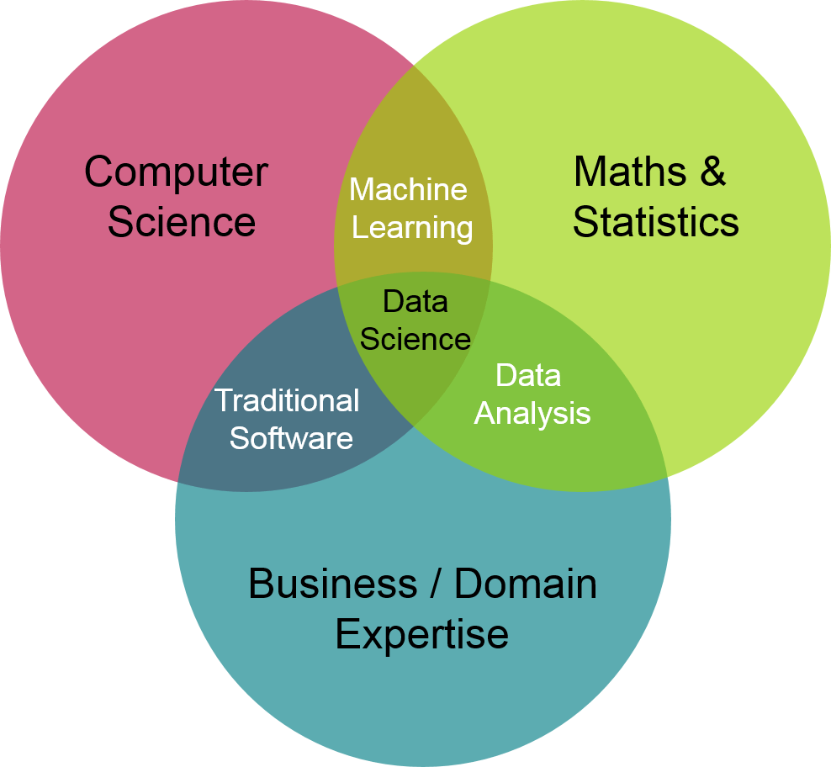
Data Science
Automate
Optimize
Data Science – Venn Diagram
Stelios Kampakis, thedatascientist.com
Notes:
Business acumen

Slide 3
The Data Science Process
Ask an interesting question
Get the data
Explore the data
Model the data
Communicate and visualize the results
Notes:
-Fly through this part-
This is the typical workflow, today we’ll focus on number one.

Slide 4
The Data Science Process
Ask an interesting question
Get the data
Explore the data
Model the data
Communicate and visualize the results
Notes:
OK, but what are the best questions to ask?

Slide 5
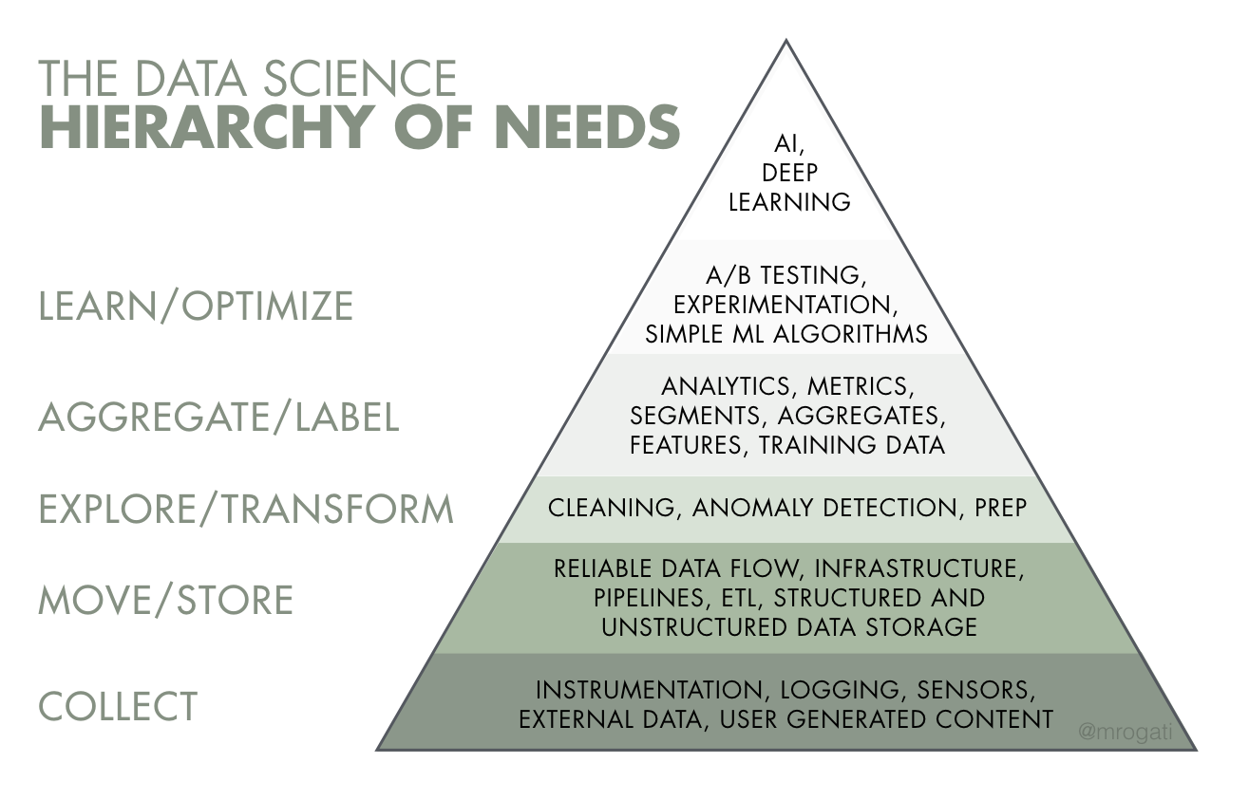
Requirements
"Maslow’s Pyramid of Data Needs“
Monica Rogati, @mrogati

Slide 6
What We’ll Talk About
What makes a good data science project
Estimating the feasibility and value of projects
Objectives and Success Criteria
Project Preparation Checklist
Notes:
———— Section Break ————

Slide 7
Project Characteristics
What makes a good data science project
Estimating the feasibility and value of projects
Objectives and Success Criteria
Project Preparation Checklist
Notes:
———— Section Break ————

Slide 8
What makes a good data science project
Good return on investment (ROI)
Easy to implement
Does not build on technical debt
Notes:
If you can save time (FTEs), you’re being useful.
Your team will be working on projects for a long time, so the order with which you implement projects is very important

Slide 9
Project Characteristics
Other factors
Data infrastructure already in place
Lots of labeled data already available
Buy-in from stakeholders
Impact of error is low

Slide 10
Business Value
The project should generate a specific prediction for a specific task
Businesses are comprised of work flows that turn inputs into outputs
Work flows are made up of tasks
Notes:
Goldman Sachs IPO is a work flow comprised of 146 distinct tasks

Slide 11
Project Estimation
What makes a good data science project
Estimating the feasibility and value of projects
Objectives and Success Criteria
Project Preparation Checklist
Notes:
———— Section Break ————

Slide 12
Return on investment
Getting a preliminary list of projects based on return on investment (ROI)
Break work flows down into tasks
Estimate the ROI for automating each task
Estimate implementation effort (vote)
Rank the potential projects
Prioritize the shortlist based on data pyramid (take implementation into account)

Slide 13
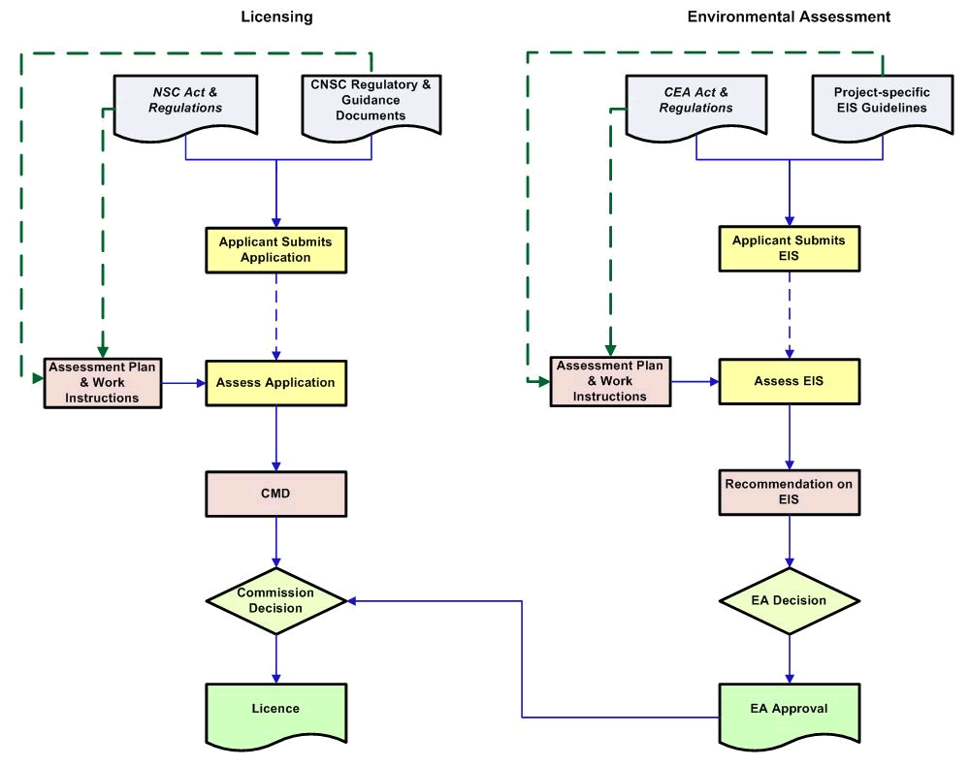
Example Process Diagram
Sample Workflow – Environmental Assessment and Licensing, CNSC
Notes:
Briefly illustrates the process when a license application for a nuclear facility project is submitted to the CNSC
Environmental assessment
Licensing process.

Slide 14
Estimation - Example Process
3h - manual
10 minutes
1 day - manual
1h - manual
1 day - manual
4h - manual
100x per year
5000x per year
30 days - committee
3 days - committee
Sample Workflow – Environmental Assessment and Licensing, CNSC
Notes:
Briefly illustrates the process when a license application for a nuclear facility project is submitted to the CNSC
Environmental assessment
Licensing process.

Slide 15
Estimating ROI
Automated tasks
ROI = (time saved × salary)
– (dev time × dev salary + operating cost)
Decision support
ROI = (operating cost of process × percentage efficiency gains)
- (dev time × dev salary)
Notes:
Caveats: data infrastructure, model iteration, so always include a fudge factor

Slide 16
Estimating ROI – Fudge factor
Automated tasks
ROI = (time saved × salary)
- ff (dev time × dev salary)
- operating cost
Decision support
ROI = (operating cost of process × percentage efficiency gains)
- ff (dev time × dev salary)
Notes:
Unless you are a time estimation demi-god, use a fudge factor. At least double it. MS triples it.

Slide 17
Estimation - Example Process
10
Est. ease of implementation
5
0
0
5 M
10 M
Est. ROI
Notes:
Vote for ease of implementation 10-point scale

Slide 18
Estimation - Example Process
10
Est. ease of implementation
5
0
0
5 M
10 M
Est. ROI
Notes:
Further along the diagonal means project

Slide 19
Account For Implementation
Break work flows down into tasks
Estimate the ROI for automating each task
Estimate implementation effort (vote)
Rank the potential projects
Prioritize the shortlist based on data pyramid
Notes:
Work with the future in mind, and your team will probably be doing multiple data projects on the same process in the years to come
So between 2-3 projects, pick ones that lay your data groundwork
That’s why in many, many programs, data visualization projects are often a great first step, as they force all the discussions to happen at the base of the pyramid.

Slide 20
Objectives and Success Criteria
What makes a good data science project
Estimating the feasibility and value of projects
Objectives and Success Criteria
Project Preparation Checklist
Notes:
———— Section Break ————

Slide 21
Objectives and Success Criteria
Write down the goal of the project with stakeholders/clients
Tighten the project boundaries. Beware of scope creep!
Use SMART criteria

Slide 22
SMART Criteria
Specific
Target a specific area for improvement
Measurable
Quantify or at least suggest an indicator of progress
Achievable
State goals that don’t require miracles
Relevant
State what results can realistically be achieved, given available resources
Timely
Specify when the result(s) can be achieved
Notes:
Peter Drucker
S: Item in work flow, just one. Who/what are clear. Not e.g. “reach a wider audience”, but “improve visits to our site from mobile”.
M: Need a framework in place to capture indicator (ML models usually track this). Number of hits. Average time per action. Total cost of decision.
A: Reality check. Data quality. What models can do. Don’t bite off more than you can chew.
R: Use process flow, but don’t optimize paperclips
T: Time-bound: Time component to project (e.g. sub 200ms). The project itself is using deadlines and breakpoints

Slide 23
It’s OK to Fail Early
Your time is your most valuable resource, and you are doing R&D
Set up project pass/fail breakpoints
Notes:
Breakpoints need to be well communicated

Slide 24
Project Preparation Checklist
What makes a good data science project
Estimating the feasibility and value of projects
Objectives and Success Criteria
Project Preparation Checklist
Notes:
Please consider the following as a little checklist to take up before sinking too much time into a project. *

Slide 25
Set project goals and expectations
Make sure the intended goal is clear and scope is narrow
Make sure business managers are involved and know what to expect
Notes:
I’m all for experimentation, but once you start sinking time into a project, make sure it’s with an end goal in mind.
Your imagination (or others) can start spinning. Make sure to curb that.
Above all else, make sure your seniors are aware, on board, understand the limitations, etc.

Slide 26
Know Your Data
Make sure you know what data you’ll be relying on.
Notes:
We collect a ton of data, shouldn’t be a problem to combine it all, right?
Make sure you’ve seen the data it’ll be relying on first.
This also applies to data quality.
Make sure data model is either existent or easily achievable.

Slide 27
Involve Domain Experts
Domain experts are at the table, and regularly provide feedback on project.
Notes:
There will always be things about the business or the data that is not documented, etc
Again, goal of data science is to bring value to an org
It is your job to create the human relationships with SMEs and make sure their knowledge is captured
Prickly, not a newcomer “trying to automate their job”

Slide 28
Ethical Considerations From The Start
You consider the ethical impacts of the project before investing time in it.
Privacy
Consent
Bias
See Algorithmic Impact Assessment tool
helps identify the impact of your automated decision system under the Directive on Automated Decision-Making
Notes:
DS Ethics is a large beast to tame, but requires to think of consequences before moving forward
Have an ethics checklist in place, see previous talk, deon

